Slide 1
Buzz Question
What do we need to do as parents?
Notes:
Based on the threats and risk discussed in the previous session, asked them what do they need to do as parents?
Wait for them to answer PROTECT/PROTECTING them before proceed to the session.

Slide 2
PROTECTING MY ADOLESCENT
Notes:
Title Slide

Slide 3
Session Objectives
By the end of the session, the participants will be able:
Recognize effective ways and measures to PROTECT adolescents from threats and risks
Identify other agencies and institutions that are working for the protecting of adolescents.
Notes:
Articulate the Session Objectives

Slide 4
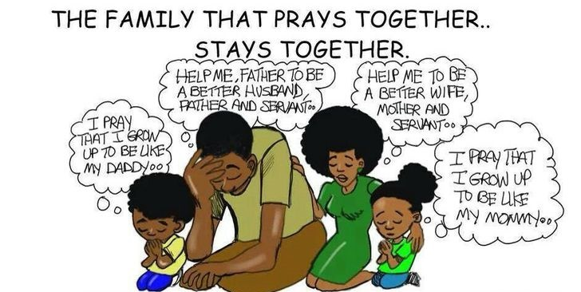
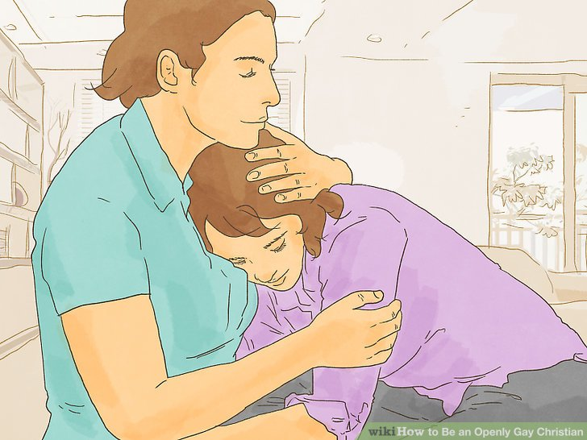
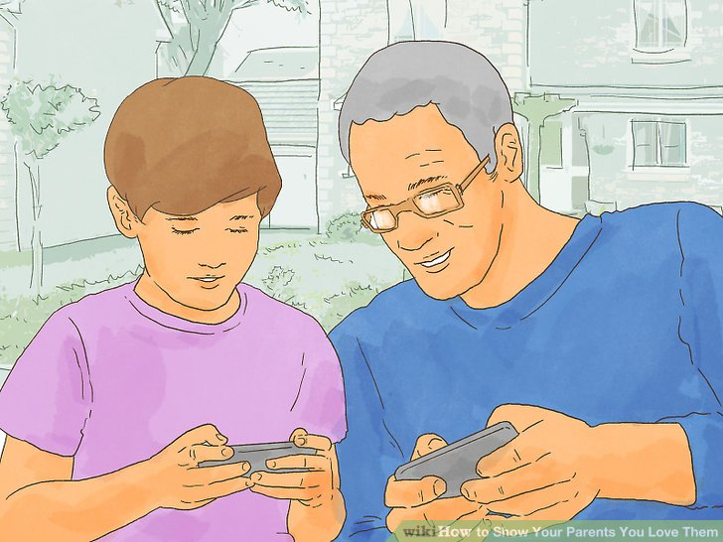
PROTECTS
Pray for and with your Children
Provide your children with physical care, love and all their needs.
Notes:
Pray for and with your Children
There is a saying, The family that prays together stays together.” Prayers are your strongest weapon against all the threats and risk faced by your children.
Prayerful parents get wisdom and positive behavior in dealing with their children.
Praying time is the best time for both parents and children to strengthen their relationship with each other and for putting God in the center of that relationship.
DEEPEN discussion. ASK participants how they show their love and care for their children.
Provide your children with physical care, love and all their needs
The physical, emotional and mental health of our children depends on the quality of care when they are growing up.
As parents, you should have an obligation to your children. You were the ones who brought them into this world. You should be ready to provide them with all their needs.
TELL the participants about the different agencies and institutions which can be tapped in this undertaking (refer to the supplementary materials for the list)

Slide 5
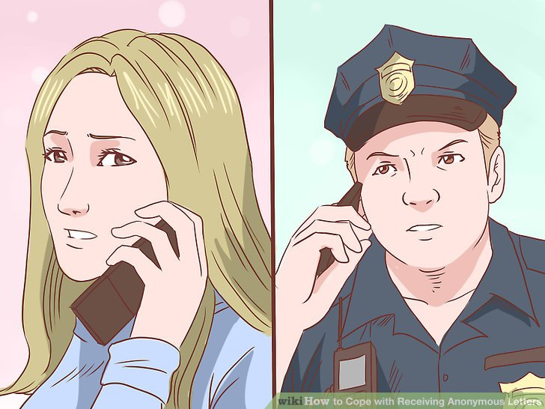
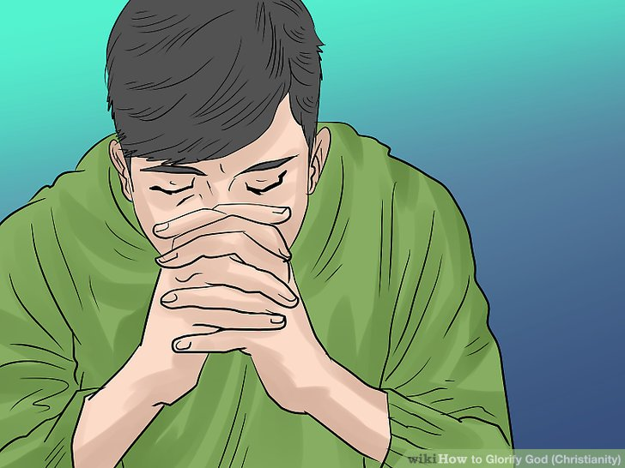
PROTECTS
Report to authorities any untoward incidents/threats to the adolescent's life
Raise children to be God-loving and God-centered
Notes:
Report to authorities any untoward incidents/threats to the adolescent's life
Parents should be vigilant and take action if any untoward incident happens to their adolescents. There are many agencies and institutions who can help in this regards.
GIVE special emphasis to this.
Raise children to be God-loving and God-centered
You are responsible for the spiritual formation of your children; bring them closer to the Almighty through involvement in Church activities.
ASK participants to cite activities of their children which they usually join

Slide 6
PROTECTS
Observe activities whenever/wherever possible
Notes:
Ensure that you are aware of your children’s activities both home and outside.
If possible, you should join your children’s activities. This will strengthen the bonding between you and your child/children.
TELL participants that this is a must for parents

Slide 7
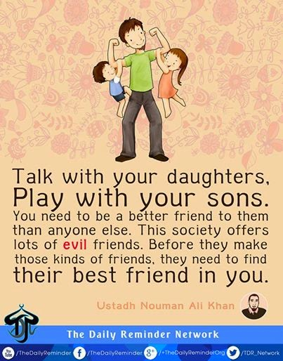
PROTECTS
Treat your children equally
Take enough time to be with your children
Notes:
Treat your children equally
As parents, you should ensure that you treat your children fairly and equally. Unequal treatment among siblings may result in rivalry and jealousy.
ASK the participants if they agree with this.
Take enough time to be with your children
Quality time that you spend with your children is just as important as the quantity.
You should reach out to your children to ensure a harmonious relationship with them.
ASK participants to share their personal experiences regarding this. ASK them if they still remember the values that their parents taught them and which of these have they passed on to their children (particularly those pertaining to sexuality)

Slide 8
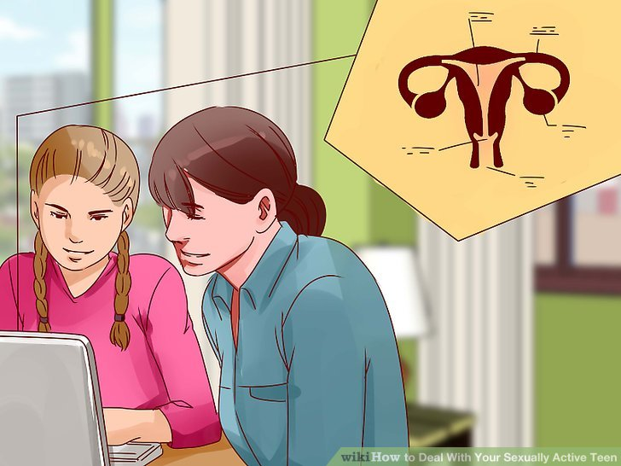
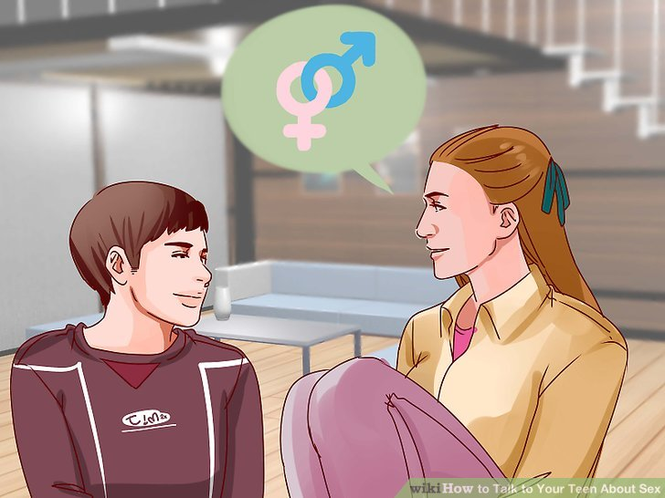
PROTECTS
Educate your children on proper values, specifically on sexuality and healthy lifestyle
Empower your adolescents
Notes:
Educate your children on proper values, specifically on sexuality and healthy lifestyle
Parents are the children’s first teachers and the home, their first school. Suitable learning experiences must be provided in the home to hasten their mental development as early as infancy.
Parents are duty-bound to discover and help developed their children’s innate talents and abilities to the fullest extent possible.
Every child has the right to education. Parents are required to provide for their children’s schooling
One of the most important things parents can do is to help their children develop a healthy attitude towards sexuality and develop a healthy lifestyle.
Each family has its own set values on different subjects, including sexuality. Some of these values are based on religion, culture and/or life experiences.
Value-laden “messages” about sexuality should be taught to adolescents during casual conversations and interactions with them. These are “teachable moments” or daily opportunities for parents to educate their children.
While it may not happen overnight, meaningful and fruitful conversations will transpire.
ASK participants how they empower their adolescents. Encourage exchange of ideas/experiences.
Empower your adolescents
Empowered children and adolescents are described as friendly, happy, self-confident, responsible, imaginative, creative, alert, and energetic. They have a positive attitude towards life, they enjoy work, and have good interpersonal communication skills.
All these positive traits can be achieved if adolescents have high self esteem. This is developed by allowing them to do things on their own, think themselves, and make decisions in accordance with their level of development.
Self confidence is an important component of social competence. This is developed by praising children for their efforts and congratulating them for their success. If they fail, encourage them to try again.
ASK participants for reactions to this.
RELATE to growing acts of violence committed by young people and to the increasingly young age at which the youth engage in sex.

Slide 9
PROTECTS
Censor/Choose mass media (radio, TV, print and IT/electronic media)
Notes:
The media are emerging as the new “surrogate parents”. They are fast becoming the adolescents’ main source of information and guide to “what is right or wrong.”
Media, to a great extent, exert great influence on the youth through the programs they watch, the books/magazines they read, or the music they listen to.
The media highlight and glorify risk-taking behavior and unhealthy lifestyles (i.e. alcohol and substance abuse, violence, early sexual involvement, impulsive decision-making, etc.)
As parents, you should give your children rules and guidelines for watching TV or reading print materials.
You should develop your children’s critical attitude and censorship of media messages and images.
Moreover, as parents you must advocate that media practitioners be involved in youth issues, especially in the dissemination of correct information as regards to youth health and development.
TELL participants that skills are inherent in their adolescents, but they have to be guided on how to use and enhance these skills.
ASK participants how they can assist their adolescent in harnessing the skills in them

Slide 10
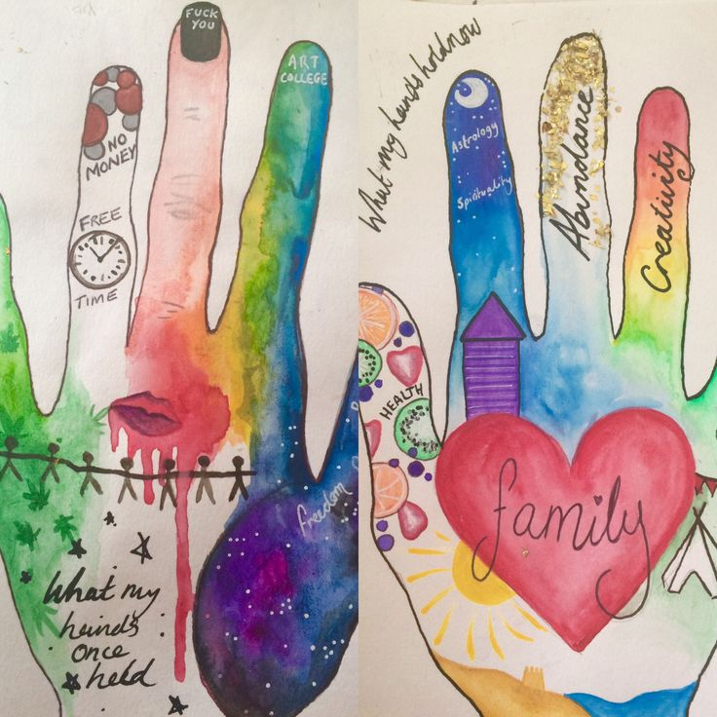
PROTECTS
Teach them the practical life skills/self defense
Tell them what their options are and how they can best protect themselves
Notes:
Teach them the practical life skills/self defense
As parents, you need to nurture the inherent skills of your adolescents so that they can develop critical thinking and questioning skills.
You can help them develop the necessary attitudes, values and skills to resist peer pressure and say “NO” to unhealthy lifestyle and behaviors.
You can advise them how to handle themselves in potentially dangerous situations.
ASK participants to share their personal experiences in relation to this.
Tell them what their options are and how they can best protect themselves
You should help your adolescent realize that there is more than one way to handle a situation.
ASK participants how they ensure that their family is very much connected. Encourage exchange of opinions and sharing.

Slide 11
PROCTECTS
Stay connected and strengthen family relationship
Sustain active interest and involvement of the community.
Notes:
Stay connected and strengthen family relationship
Family relationship, particularly that between parents and adolescents is a powerful determinant in shaping the values, behavior and choices of young people.
Your children watch how you and other significant adults behave and pay more attention to what adults do than what they say.
Your stories from the past can give adolescents a more meaningful view and a clearer understanding of the past and serve as lessons for the to learn from.
DEEPEN discussion. RELATE this to the growing clamor of adolescents to be active implementers of community programs.
Sustain active interest and involvement of the community.
At the core of protecting your adolescent is active and continuing community support and involvement
The active involvement of the community will ensure sustainability of efforts in protecting your adolescents and facilitating their development.
As parents, you need to help raise awareness about the needs, concerns, threats and risks facing your adolescents.

Slide 12
KEY MESSAGES
YOU should always remember that your adolescents are your future! When you protect them, you safeguard not only their present, but also their future.
As PARENTS, you have a big role to play in your children’s development. Play it well!

Slide 13
MARAMING SALAMAT PO. ☺

