Slide 1
THE FILIPINO FAMILY
Notes:
Title Slide

Slide 2
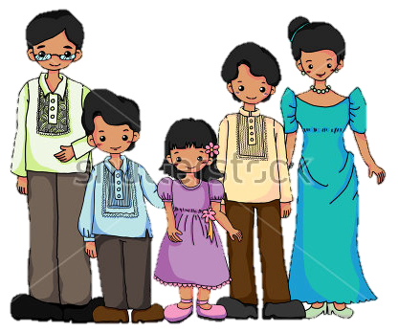
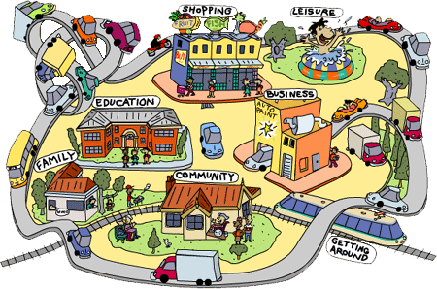
Understanding the Adolescent
Family
Church
Schools
RHU
Healthy Adolescents
Other sectors in the community
Notes:
Tell that based from the previous session on municipal health situation, you have seen the current status of the municipality in adolescent health. This next session will highlight the relevance of the family in curbing or shaping the life of an adolescent. Also, say that the family is the basic foundation where the child starts to develop into adolescents.

Slide 3
Session Objectives
By the end of the session, the participants will be able:
Discuss the profile of Filipino Families
Understand the different types of Filipino families and the factors that shape these families
Know the advantages and disadvantage of each family type
Notes:
Articulate the Session Objectives
Discuss the profile of Filipino Families
Understand the different types of Filipino families and the factors that shape these families
Know the advantages and disadvantage of each family type

Slide 4
THROUGH THE YEARS
Describe the Filipino Family during your time (60’s -70’s, 80’s, 90’s and 2000s)
Write our perception/view of the Family based on the following: (10-15 minutes)
Role
Relationship
Lifestyle
Leisure/recreation
Present in the Plenary
Notes:
Divide the participants into small group of at least 4 at most 8 members each group, according to age group (e.g. Group 1- ages 41 and up; Group 2- ages 30 to 40, Group 3-ages 20- to 29). Ask them to name their group (10-15 minutes). Facilitator gives examples for each category.
Introduce the activity by saying” Through the years, we have seen a lot of changes in our society. As society changes , our families change too. In this activity, we will recall the many changes that Filipino families have undergone.
Each group will describe the Filipino family during their time (2000s, 90s, 80s, 60s-70s)
Write their perception of the family based on roles, relationship, lifestyle and leisure/recreation in the metacard. Post answers in Manila paper
Facilitator processes the output of the workshop where answers can be regrouped based on the common understanding of the participants.
Further, answers can be clarified with participants through specific examples.
Emphasize how families have changed overtime in the various key areas of family life

Slide 5
Processing
How do you feel about the activity? Why?
What were the similarities and difference in the role, relationship, lifestyle and recreation over time?
What were your realizations during the activity?
Notes:
Processing Question:
How do you feel about the activity? Why?
-participants may answer differently (sad, happy, worry) then ask the rationale for the feeling
What were the similarities and difference in the role, relationship, lifestyle and recreation over time?
What were your realizations during the activity?
Publish and clarify answers. Ask participants what they have noticed about the structure of the family overtime and ask what do they think are the reasons for the changes? Then proceed to the next slide by saying” lets see if answers match to what has been identified as reasons for the changes in roles, relationships, lifestyle and recreation overtime”

Slide 6
The Filipino Family
Families have changed due to:
Rapid urbanization
Geographic mobility
Globalization
Increasing number of women employed locally or overseas
As society changes, so does the structure of the family
Notes:
Tell that Families are not what they used to be. Then describe the reasons for the changes in the family
Families have changed due to: (Ask examples and clarifications)
Rapid urbanization
Geographic mobility
Globalization
Increasing number of women employed locally or overseas
3. Emphasize that as society changes, so does the structure of the family. Ask participants for examples.

Slide 7
The Filipino Family
Changes in social, political, economic and cultural conditions have also led to changes in the lifestyle, needs, roles and relationships of Filipino families
For some families, economic hardships led to deterioration in emotional well-being and health of family members
Notes:
Changes in social, political, economic and cultural conditions have also led to changes in the lifestyle, needs, roles and relationships of Filipino families. Ask specific examples from the output.
For some families, economic hardships led to deterioration in emotional well-being and health of family members and say that there has been noticeable increase in the disintegration and break-up of families

Slide 8
Buzz Session
What do you think are the different types /forms of families that we have now?
Notes:
Buzz session, group with 3 members each and discuss the question “what do you think are the different types /forms of families that we have now? (3 minutes)
Let participants write answers in metacard and Share to plenary the identified types of families and publish. Then relate answers to the next slide.

Slide 9
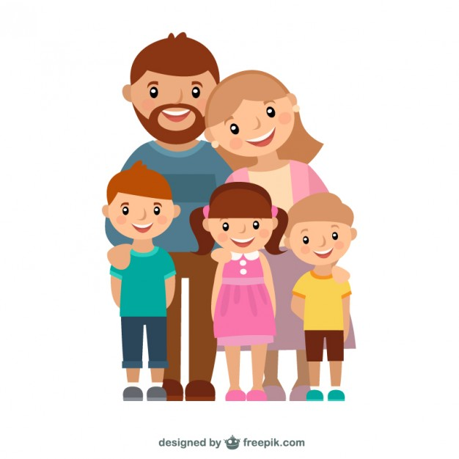
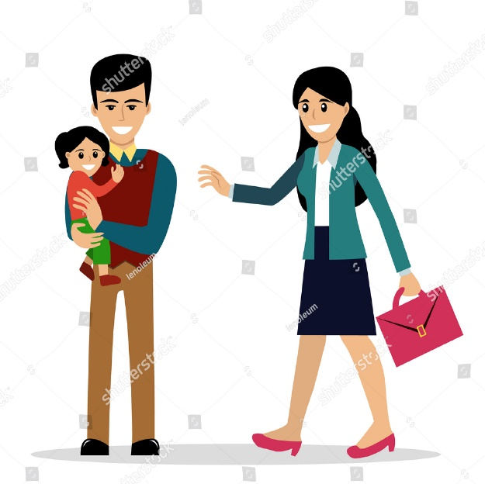
Filipino Families of Today
Families with working mothers
Families with stay home dad
Single parent/ solo household
Families with parents apart
Blended families
Notes:
Ask participants what is basic the of the family? Say that it is composed of Father, Mother and Child. Then tell that based on the changes of the family structure overtime, these are now the new structures of the family. And relate these to the answers of the participants
Families with working mothers
Families with stay home dad
Single parent/ solo household
Families with parents apart
Blended families-a family composed of a couple and their children from previous marriages.
2. Ask what do you think advantages and disadvantage of being a working mother?
At present most Filipino homes have working mothers. With high cost of living and changing lifestyles the average income is not enough to support the family

Slide 10
Filipino Families of Today
Balancing the pressure of work and family life is difficult when maintaining a standard of living
Couples starve for time with additional work efforts and sometimes create stress for the family and problems in providing sufficient care and supervision of children
Notes:
Ask if there are working mothers in a group and let them share their experience/insight/learning in balancing the demand of work and family life
Emphasize that balancing the pressure of work and family life is difficult when maintaining a standard of living
Couples starve for time with additional work efforts and sometimes create stress for the family and problems in providing sufficient care and supervision of children

Slide 11
Filipino Families of Today
Latchkey Families are those whose parents are unavailable to take care of children and ‘latchkey’ refers to children that have their own keys to allow access to the family home
It is important that parents maybe not around, there is someone who can provide psychological support and supervision
Notes:
Say that there are also another type of family that has emerged due to the need for parents for work. Mention about latchkey families.
Latchkey Families are those whose parents are unavailable to take care of children and ‘latchkey’ refers to children that have their own keys to allow access to the family home. Examples of latchkey families are families where both parents are working and unable to supervise their children before and after school and even on school holidays.
It is important that parents maybe not around, there is someone who can provide psychological support and supervision. Sometimes elder relatives, brother/sister or family friend assumes the role of parents. Leaving children on their own poses both psychological and physical dangers.

Slide 12
Filipino Families of Today
Latchkey syndrome is disadvantageous when left alone. Studies show that these children are more likely to experiment with sex, drugs and alcohol specially after school hours
Latchkey children may suffer from:
Fear
Boredom
Loneliness
Vulnerability to academic problems
Notes:
Ask participant on what happens to children or adolescents that come from a latchkey family. Tell that there is what you call a Latchkey syndrome. Explain Latchkey syndrome is disadvantageous when left alone. Studies show that these children are more likely to experiment with sex, drugs and alcohol specially after school hours
Say that Latchkey children may suffer from:
Fear
Boredom
Loneliness
Vulnerability to academic problems
Ask parents if this true?

Slide 13
Filipino Families of Today
The attitude of parents towards any of these family situations is a key factor in shaping the child’s expectations and experiencing
What is important is to keep the communication lines open
Notes:
Tell that because family structures have change it is important that the attitude of parents towards any of these family situations is a key factor in shaping the child’s expectations and experiencing and What is important is to keep the communication lines open
Transition to the last slide by saying that knowing the Filipino family Is important because:

Slide 14
Key Message
Family structures and functions change with social change
Parents’ attitude towards the new family structures is critical in shaping the child’s experience and expectation as he/she becomes an adolescent
Be open to communication
Notes:
Family structures and functions change with social change
Parents’ attitude towards the new family structures is critical in shaping the child’s experience and expectation as he/she becomes an adolescent
Be open to communication
Close the session by saying that the Filipino family play a critical role in contributing to the experiences and the journey they will be undergoing. Then say that the next session will explain further the journey of an adolescent.

Slide 15
Maraming Salamat Po ☺
Notes:
1. The basic foundation of a child’s experience as he/ she becomes an adolescent is the family. The family experience then contributes how the adolescent thinks and behaves during this phase which can be described in different ways. The next session will no describe the journey of adolescents undergo during the phase of their life.

