Slide 1
Implants

Slide 2
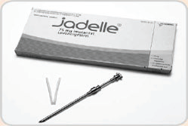
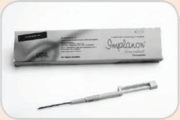
What are they
Progestin-filled rods or capsules that are inserted under the skin and release the hormone slowly over a long period to prevent pregnancy

Slide 3
Types
Norplant: 6 rods, effective for 5 years
Jadelle 2 rods, effective for 5 years
Implanon 1 rod, effective for 3 years
Sino-implant 2 rods, effective for 5 years

Slide 4
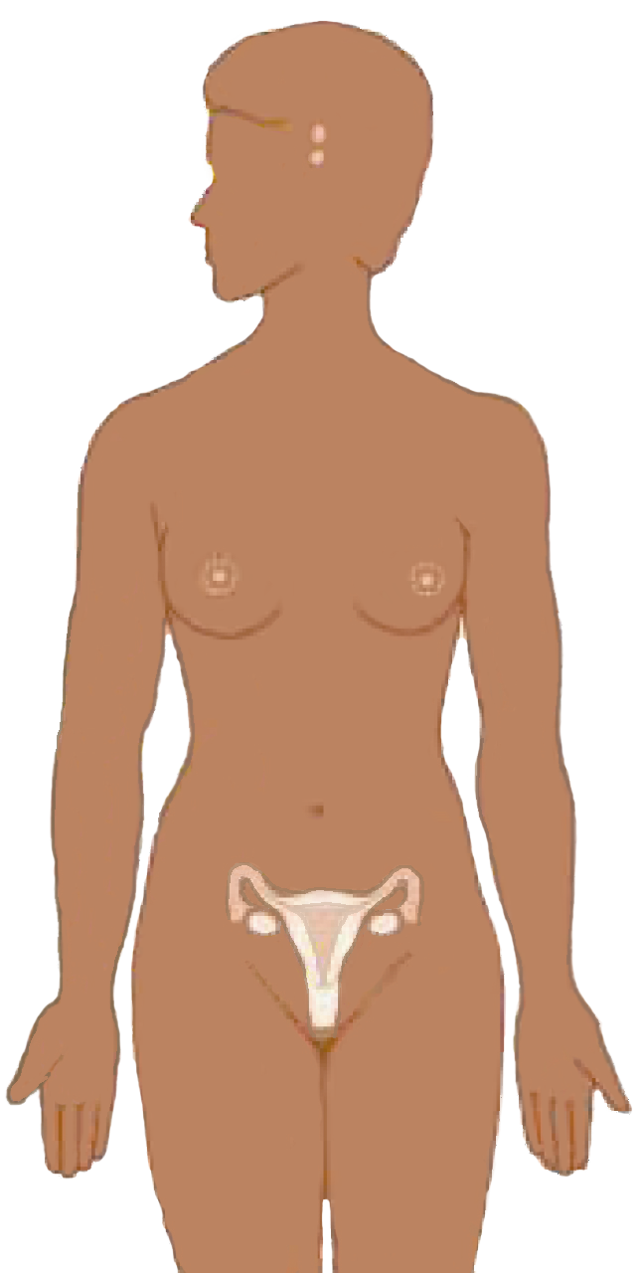
Mechanism of Action
Suppresses
hormones
responsible for
ovulation
Thickens
cervical mucus to block sperm
Notes:
Other MOA: Injectables also thin the endometrium, thus reducing the chance that a fertilized egg would be implanted.
Discussion questions:
What do women in your community believe about how injectables work? In the event that there are misconceptions about how injectables work, how can you explain the mechanism of action in simple terms?

Slide 5
Who Can Use
Women:
Of any reproductive age
Of any parity including nulliparous women
Who want highly effective, long-term protection against pregnancy
With desired family size who do not want voluntary sterilization
Who are breastfeeding (after 6 weeks postpartum)
Who are postpartum and not breastfeeding
Who are post abortion
5
Notes:
8/2/2011
5

Slide 6
Who should not use Implants
Breastfeeding women less than 6 weeks
Women with liver disease
Women with breast cancer
Women with severe hypertension,
Women with unexplained abnormal vaginal bleeding
Women suffering from deep venous thrombosis (DVT)

Slide 7
Benefits
Highly effective
Rapidly effective ( within 72 hours)
Long-term method
Does not affect breastfeeding

Slide 8
Limitations
Must only be inserted and removed by trained providers
Require minor surgical procedure for insertion and removal
Common side effects include
menstrual changes (irregular spotting or bleeding, prolonged bleeding, and amenorrhea.
Headache, dizziness, nausea, breast tenderness,
Weight changes
Does not protect against STI/ HIV

Slide 9
When to insert Implant
Anytime during the menstrual cycle when you can be reasonably sure the client is not pregnant
Days 1 to 7 of the menstrual cycle
Postpartum:
after 6 weeks if breastfeeding
immediately or within 6 weeks if not breastfeeding
Postabortion
Immediately or within the first 7 days
9
Notes:
8/2/2011
9

